Slide 1
Color Shaper full documentation
Nicolas Roux Imaging Division
Processor Architecture & Algorithm Group
August 2011 – V 1.72

Slide 2
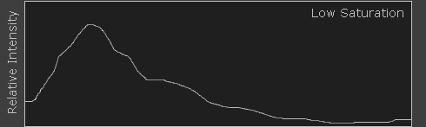
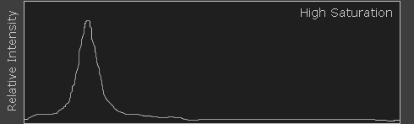
What is color’s saturation ?
Color's saturation is a measure of its purity.
• In the light spectrum world:
Low saturation
decreased
increased
decreased
High saturation
• In the RGB world:
Color saturation could be understood as the increase of the difference of R,G and B channels.

Slide 3
How to apply color saturation gain ?
There are several ways to increase the saturation, so to increase the difference between R, G and B channels:
Using the color matrix of saturation, in YCbCr or RGB. Current solution for 98x products
Converting pixels into the HSV color space. Requires full RGB/HSV and reduced HSV/RGB converters
Modifying the R, G and B channels knowing HSV color space. Derived from previous point, so equivalent to it, without an explicit
RGB/HSV/RGB converters.
Next slides details the first and last options. The second option is still interesting if we need to modify Hue and/or Value.
Note: - Hue, Saturation and Value refer to channels from HSV color space. - Luminance refers to Y channel of one of the YCbCr color space

Slide 4
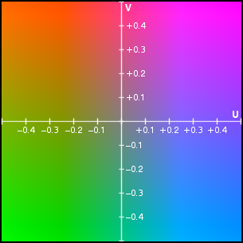
1- SaturationYUV color matrix in YUV
Saturation control in YCbCr: Multiplying Cb and Cr channels by the same amount
Low saturation
High saturation

Slide 5
1- SaturationYUV color matrix in YUV
Gamut allowed, for a given Y, in RGB color space
Saturation in YCbCr could generate colors outside the RGB possible gamut. This produces clipping in RGB and so generate Hue shift .
Saturated in YCbCr
Saturated in RGB

Slide 6
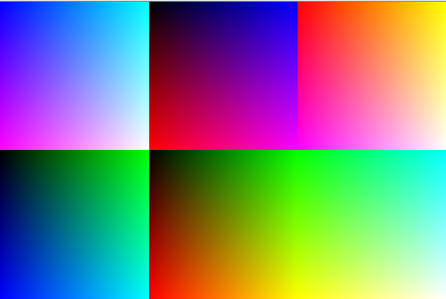
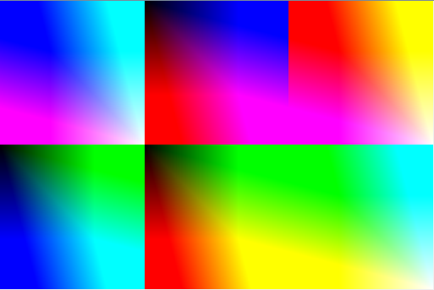
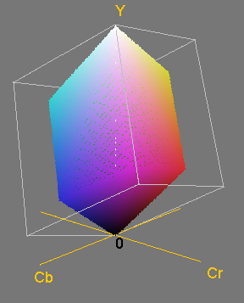
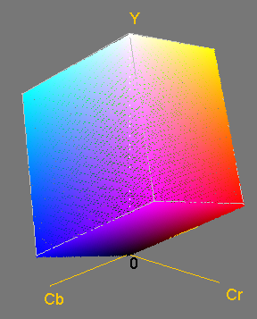
1- SaturationYUV color matrix in YUV
Saturation = 70 %
Saturation = 200 %
Saturation generate Hue shift
RGB cube is a subset of YCbCr color space.
Scaling Cb and Cr, for increasing Saturation could create clip in RGB.

Slide 7
1- SaturationYUV color matrix in RGB
Saturation control in RGB: Using a RGB to YCbCr and YCbCr to RGB, we can apply the matrix above
This becomes (depending on the YCbCr/Rgb transform):
For each pixel, the maximum Saturation is the value that will not low or high clip more one or two channels, and so preventing Hue shift.

Slide 8
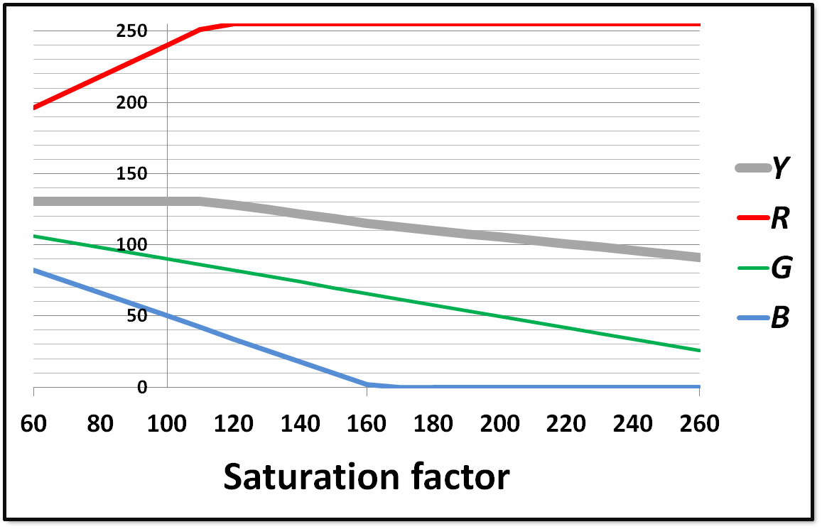
1- SaturationYUV color matrix in RGB
Effect of Saturation on R, G and B channels: the channels are moved away, linearly, from the Luminance value (as defined by the selected YCbCr transform)
Hue modified
Hue preserved
Look at HSV.pdf for understanding Hue, Saturation and Value in RGB
Hue preserved when channel not clipped. Value increased. Luminance preserved when channel not clipped.

Slide 9
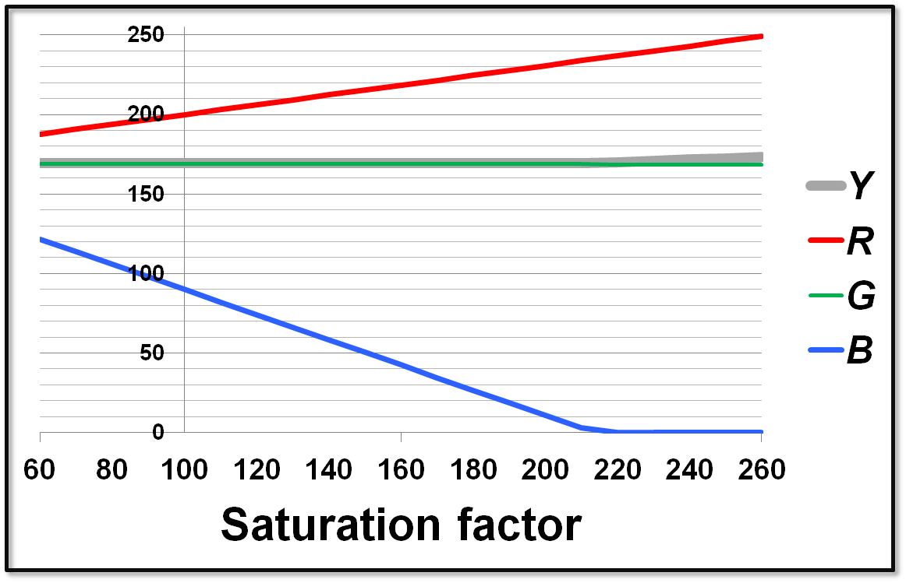
Example of green channel equal to Luminance
the green channel is not changed
Hue preserved
Hue modified

Slide 10
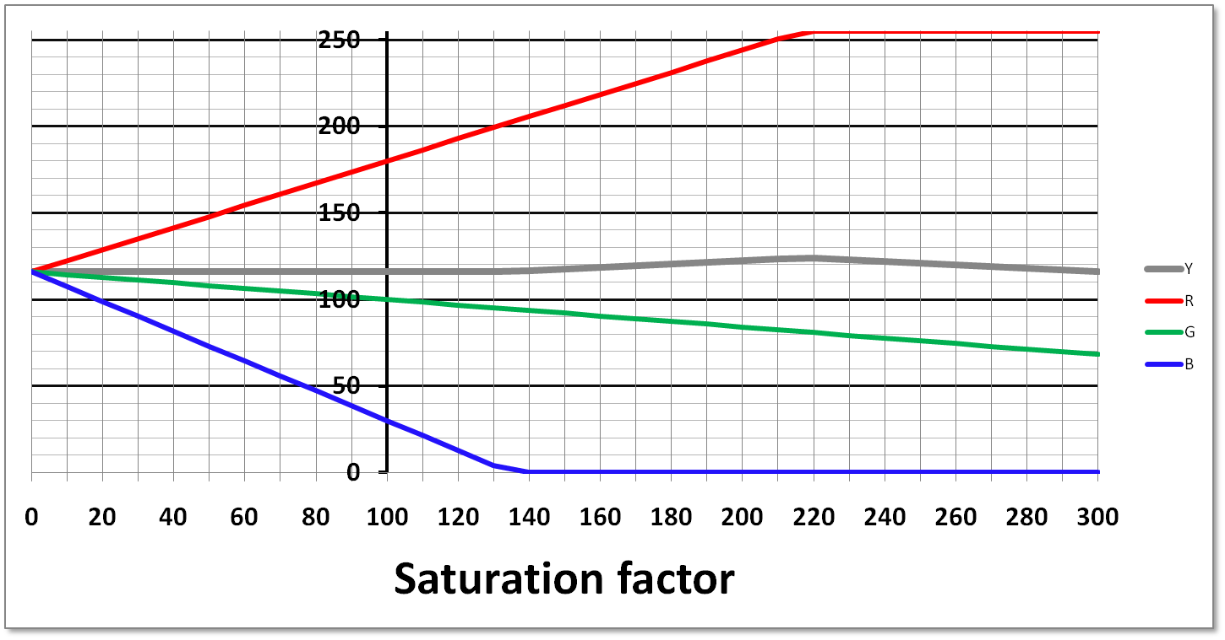
2- SaturationYUV definition in RGB
Using the saturation color matrix, we now try to redefine a color saturation channel, preserving the luminance channel. If we draw the plot of RGB relative to saturation factor, extended to a value of 0, we have:
(Blue channel reaching 0)
Sf_{max}
Saturation factor
The maximum factor of saturation, Sf_{max,} is reached with one of R,G or B reaching 0 or the maxCode. Here, we have for each triplet RGB the possible range for our newly defined color saturation [0, Sf_{max}].
This could be normalized into a [0%,100%] range.

Slide 11
2- SaturationYUV definition in RGB
Defining Saturation with Saturation color matrix: Color saturation that we define is a scaling factor of RGB channels around the Y channel. This is translated as:
Code max
Channel A
Channel A
Values of R, G and B channels
Luminance
Luminance
Channel B
Channel C
Channel B
Channel C
0
Saturation = 50%
Saturation = 100%
Defined Saturation preserves Hue (from HSV) and Luminance (from YCbCr)

Slide 12
2- SaturationYUV definition in RGB
We now normalize the defined Saturation into the [0%, 100%] scale:
(Blue channel reaching 0)
Saturation factor
0%
100%
Saturation channel
This defines a Saturation channel, different from HSV, preserving the Luminance. This Saturation and Luminance could form a new color space with an adequate Hue definition.

Slide 13
2- SaturationYUV definition in RGB
To clip Saturation factor for preserving Hue, we need to get Sf_{max}. As we are talking about a factor of saturation, we care on the maximum ratio between current pixel saturation and 100% saturation.
This is translated as:
To avoid two divisions, we can write:
By clipping the applied Saturation factor, with Sf_{max}, we ensure that no Hue shift occurs.
The cost is 1 division, 2 multiplications,1 comparator and 3 adder/sub. (If this Vibrancy is within the RGB2YUV, otherwise you need an extra RGB2Y or YUV2RGB.)

Slide 14
3- SaturationHSV control in RGB
Saturation : Among R,G and B, this is the difference of the max and the min relative to the maximum of R,G and B.
Saturation increased relative to max
Code max
Channel A
Channel A
Values of R, G and B channels
Channel B
Channel C
Channel B
0
Channel C
Saturation = 50%
Saturation = 100%
Hue and Value are not modified. (To preserve the Hue, channel B, as to be scaled also)

Slide 15
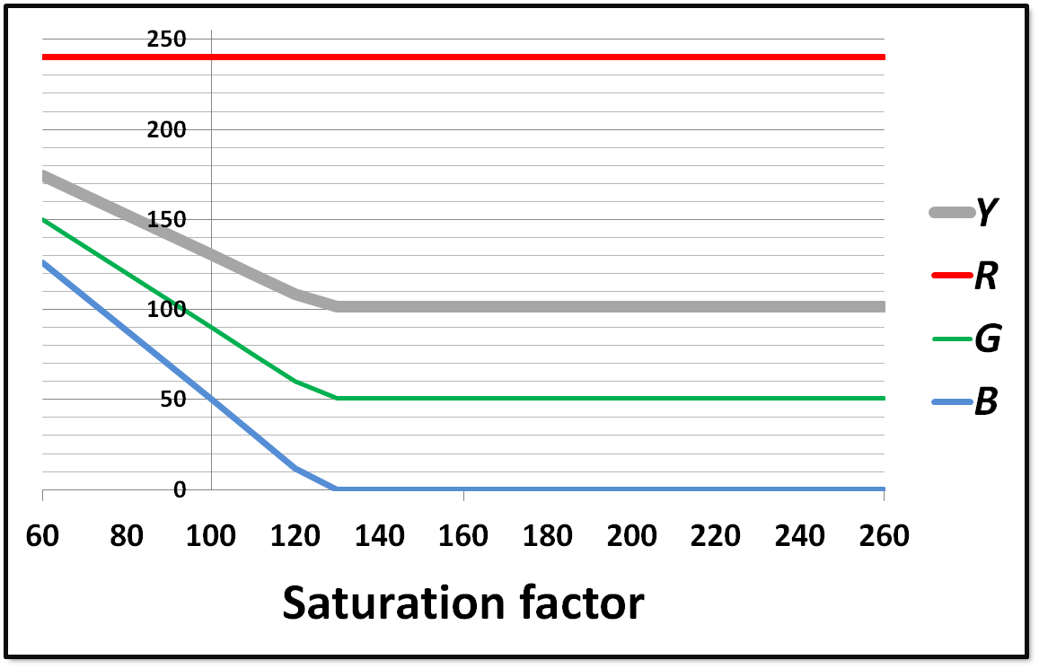
3- SaturationHSV control in RGB
Effect of Saturation on R, G and B channels: the channels are moved away, linearly, from the Red channel value.
Hue preserved. Value preserved. Luminance decreased, with Saturation increased.
Look at HSV.pdf for understanding Hue, Saturation and Value in RGB

Slide 16
3- SaturationHSV control in RGB
Value and Hue not changed
Applying a factor of color saturation : factor_{saturation}
Code max
a
a
b
c
d
e
0
Input
Output
The maximum factor_{saturation} is reached with e=0

Slide 17
3- SaturationHSV control in RGB
… and nor Value and Hue modified.
Computation of β is optional. This removes the need for division. But, this mode doesn’t prevent clipping !
Here is a linear color saturation control, in RGB : • Without the need to use a matrix. • Without clipping, and so with Hue preservation. • Without the need to convert to/from HSV. • With Value preserved but the luminance.

Slide 18
4- SaturationYUV vs. SaturationHSV
Matrix
SatFromHsv
Without clipping control
 | Saturation_{YUV} Previous solution | Saturation_{YUV} In Colour Shaper | Saturation_{HSV} In Colour Shaper
Hue | modified | preserved | preserved
Luminance | preserved | preserved | modified
Noise | To be tested

Slide 19
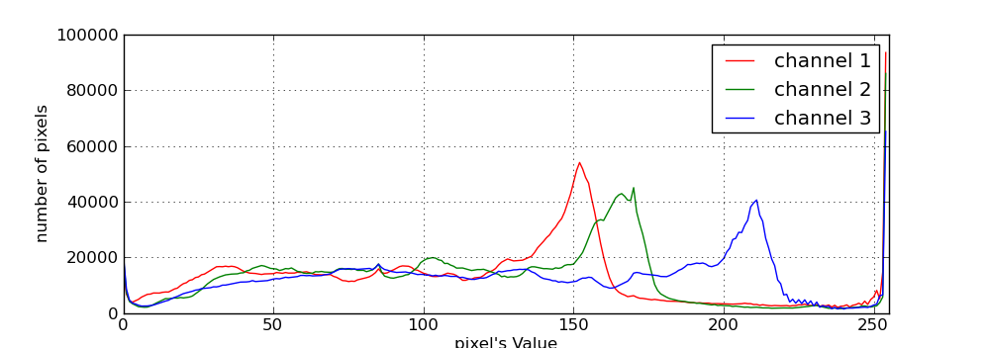
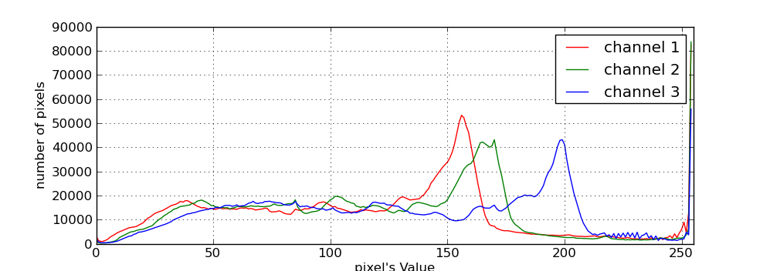
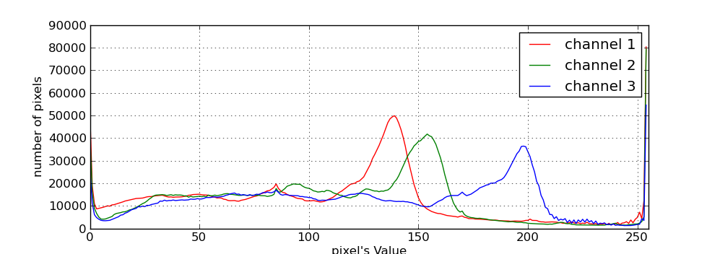
4- SaturationYUV vs. SaturationHSV
Output Saturation_{YUV}
Luminance preserved
Input
Output Saturation_{HSV}
Value preserved

Slide 20
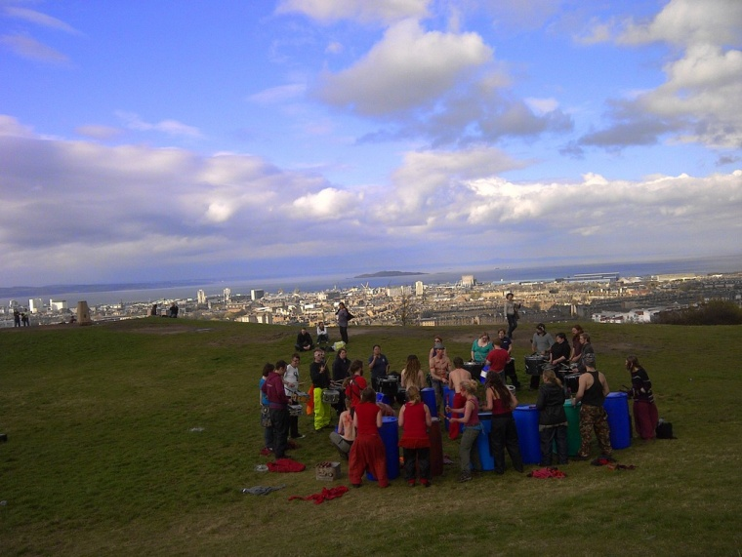
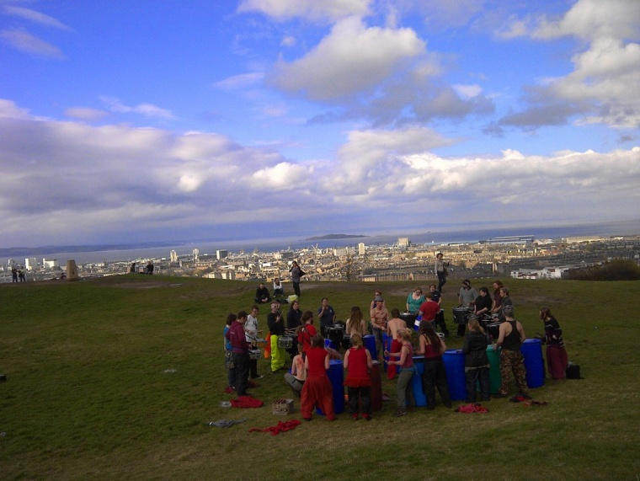
5- Using SaturationHSV
What is the effect of color Saturation in HSV ?
We have seen that increasing Saturation in HSV produces a decrease of luminance. This effect looks like a digital polarizing filter. As example, applied on a sky zone, it produces deeper blue.
This color saturation effect could be added after the saturation_{YUV}.
130% of HSV color Saturation, for the sky Hue only

Slide 21
5- Using both Color Saturation
We can use the digital polarizing filter in addition of the YUV saturation . This gives higher color saturation, even for pixels where the YUV saturation reached its maximum.
Saturation_{YUV}
Saturation_{HSV}
Code max
Channel A
Channel A
Values of R, G and B channels
Luminance
Channel B
Luminance
Channel C
Channel B
0
Channel C
Sat_{Yuv} = 50%
Sat_{Yuv} = 100%
Sat_{HSV} = 80%
Sat_{HSV} = 100%

Slide 22
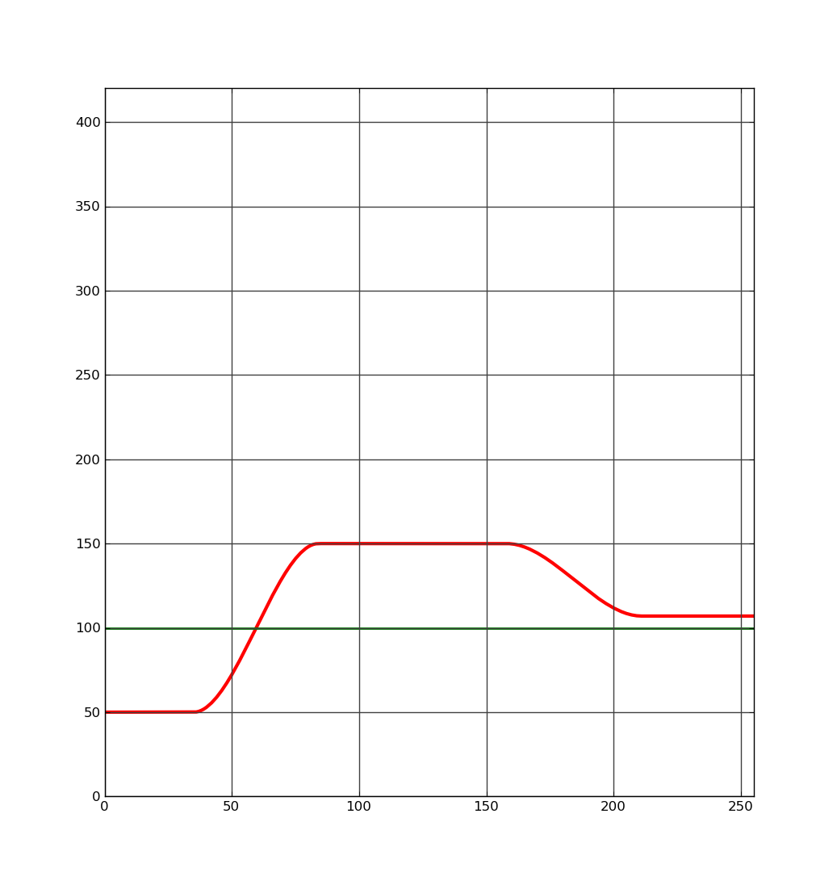
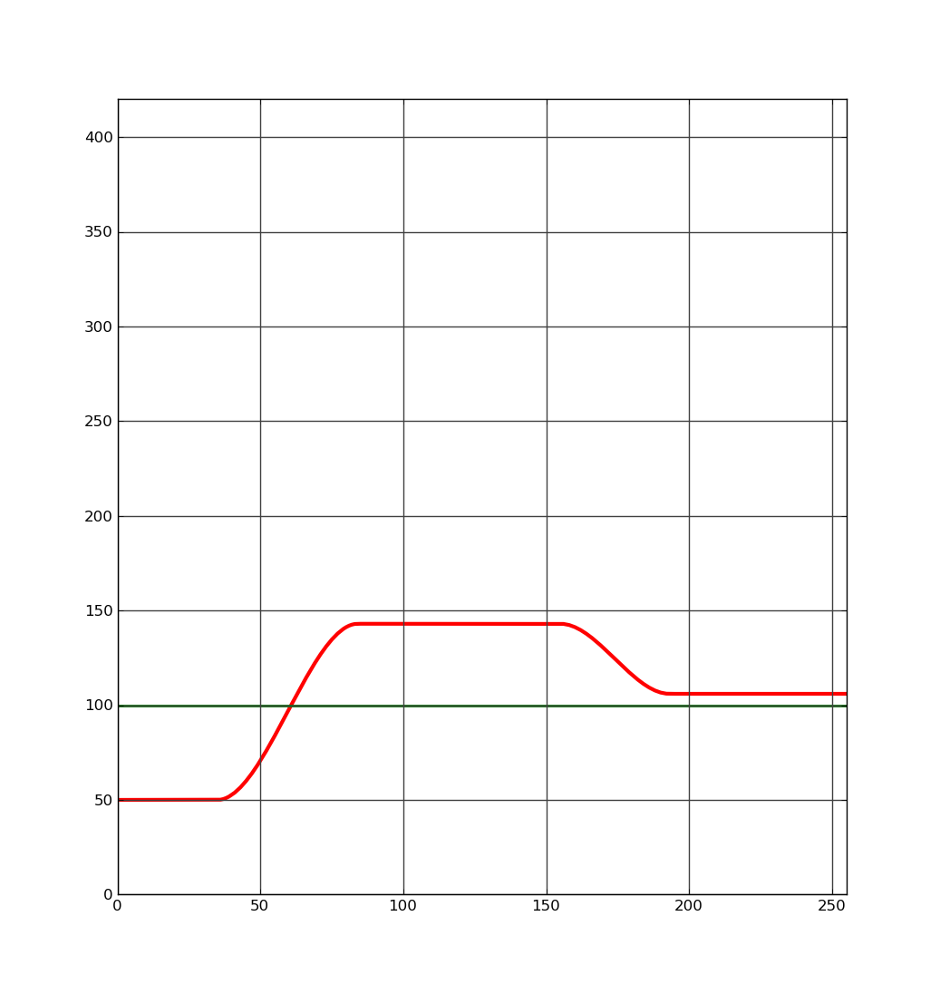
6- The crenel function
Crenel function is used as a gain, so around 100%.
top
rightFoot
leftFoot
start
left
right
end
This function allows damping of low and high values.
1
LeftFoot and rightFoot are : - top>100: relative to top - top≤100: absolute
0
0
1
Transitions are smooth:

Slide 23
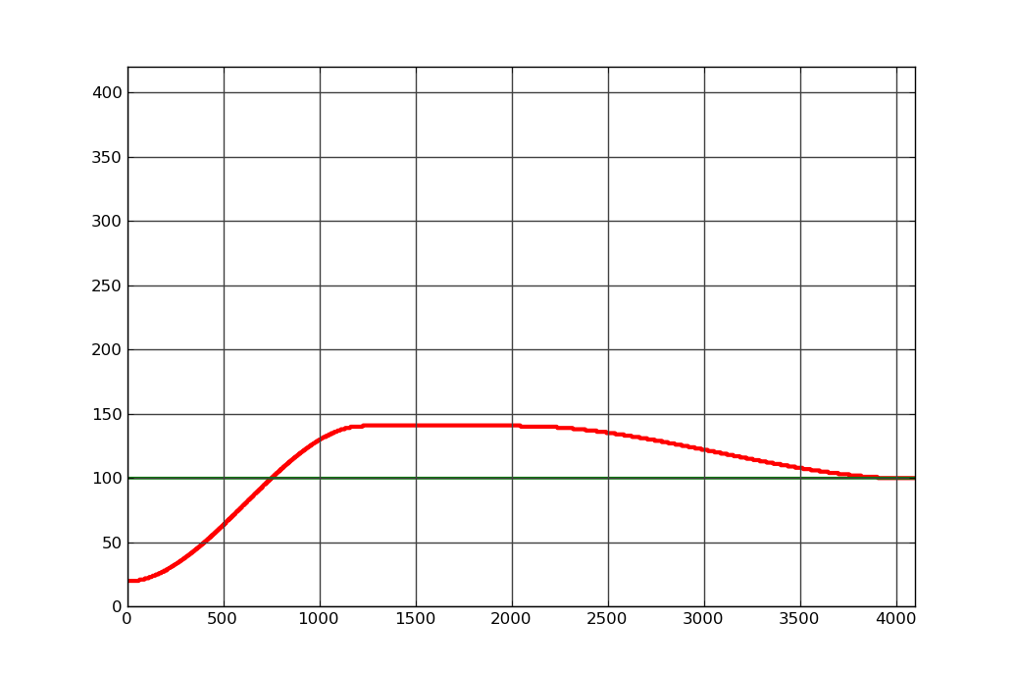
7- Non linear SaturationYUV control
Principles:
Saturation is less increased for highly saturated pixels
Preventing RGB clipping, and so preserving Hue.
Pixels with very low saturation are not much increased (reducing white balance error)
Saturation_{YUV} gain
Saturation_{YUV} in
Damp lowest saturated pixels
Fix gain of saturation
Damp highest saturated pixels

Slide 24
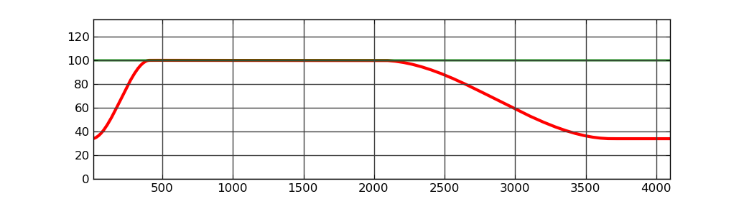
8- SaturationYUV control by Luminance
Principle of decreasing the Saturation:
For lowest Value/Luminance: Low value means color noise that can be hidden. Human vision is not very good to see color for darker Values
For highest Value/Luminance: With highest Value, one of R,G or B is probably clipped. This gives Hue shift, with Cyan sky, for example. It’s better to de-saturate pixels that have wrong Hue and strong Value
Saturation_{YUV} gain
Value or Luminance channel in

Slide 25
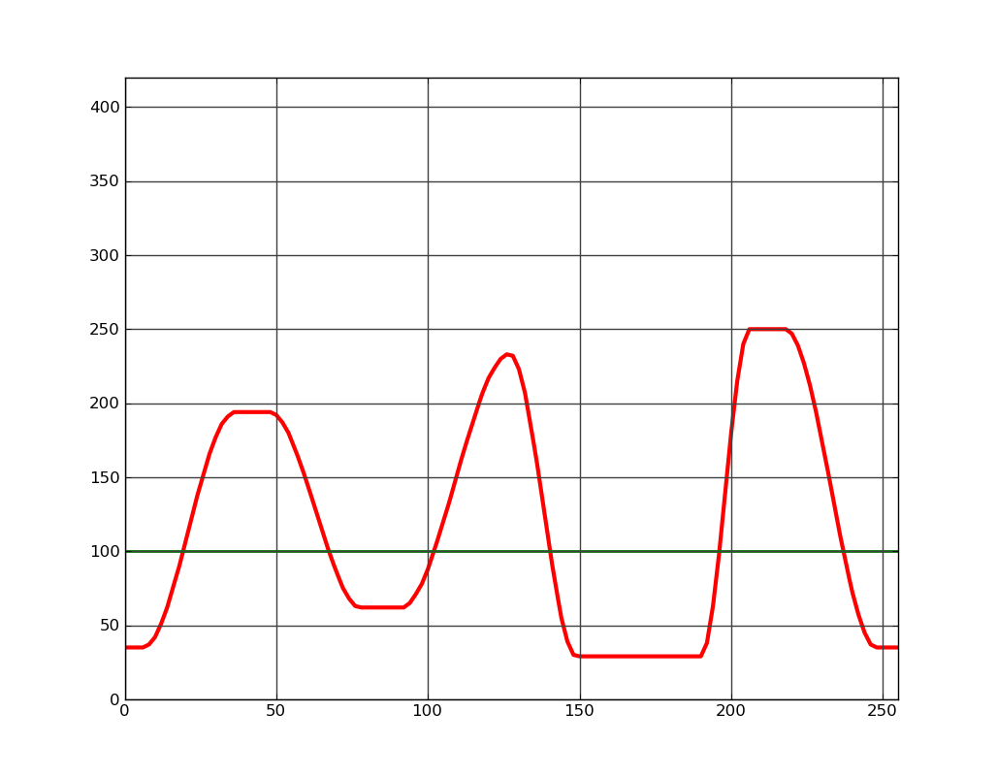
9- The comb function
Comb function is used to limit the saturation gain, so around 100%.
0%
25%
30%
30%
70%
10%
10%
0/6
1/6
2/6
3/6
4/6
5/6
6/6
This function allows to set the value of 6 points and the wideness of each, with smooth transitions.

Slide 26
9- Using comb function with Hue
Comb function is perfect to tune primary and secondary colors/Hue
10%
red
yellow
green
cyan
blue
magenta
red

Slide 27
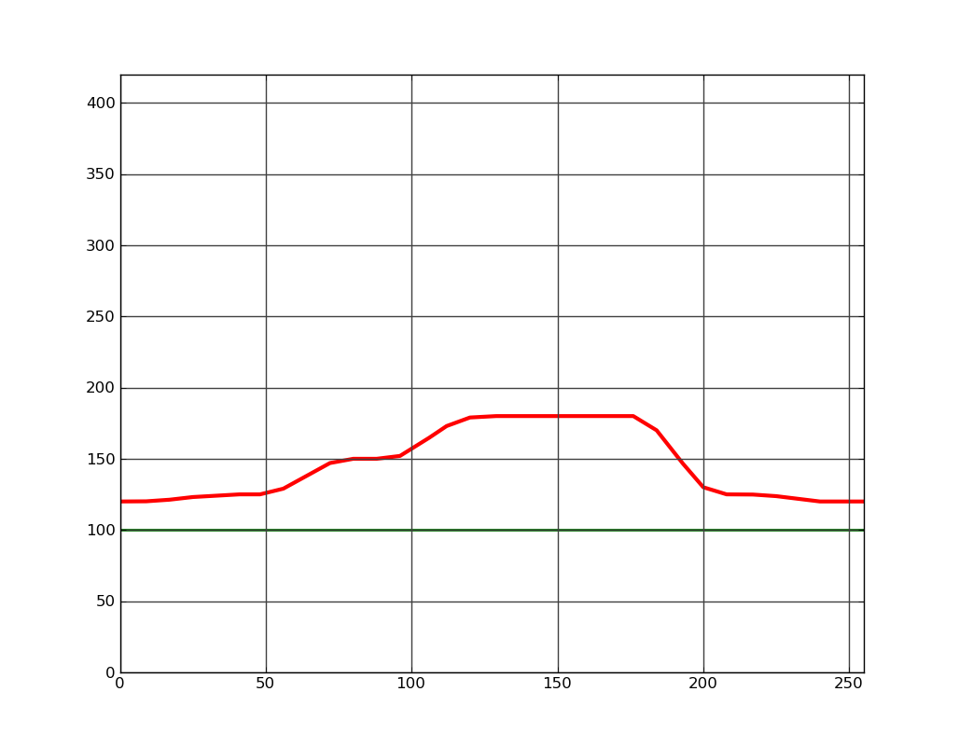
9- SaturationYUV control by Hue
Principle of Saturation control by Hue using the Comb function:
Limiting red faces: Human faces becomes reddish when saturation is too much. Could be better tuned with face detection.
Boost of vegetation and sky: Better if we detect outdoor image, thanks to WB information.
Saturation_{YUV} gain
Hue channel in
This empirical curve seems to fit with most scene. To enhance this selective saturation relative to Hue, we need to detect gamut locus, statistics that is not part of this algo, and could also use WB.

Slide 28

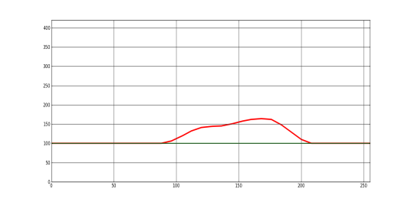
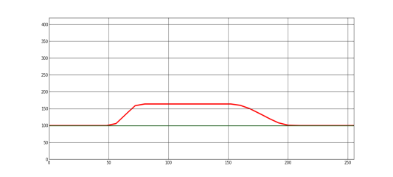
11- Micro-architecture (RGB domain, half)
RGB to HSV
S_{Max}
*Clip of saturation factor is done at LUT generation.
Hue_{HSV}
YRGB to Sat_{YUV}
Sat
*
Min
Gain of Colour Saturation_{YUV}
Saturation_{YUV}
RGB to Y
S_{Max}
Luminance_{YUV}
RGB Color matrix of saturation
HSV Saturation in RGB
RGB
RGB
RGB to HSV
S_{Max}
Hue_{HSV}
Gain of Colour Saturation_{HSV}
Min
Sat
*
Saturation_{HSV}

Slide 29
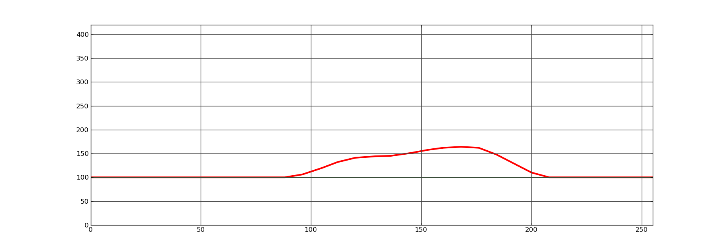
10- SaturationHSV control by Hue
Principle of Saturation control by Hue, using the Comb function :
Digital polarizing filter: The effect is limited to the sky and vegetation hues.
Saturation_{HSV} gain
Hue channel in
This empirical curve seems to fit with most scene, but better used with outdoor images. To enhance this selective saturation relative to Hue, we need to detect gamut locus, statistics that is not part of this algo, and could also use WB.
29/37

Slide 30
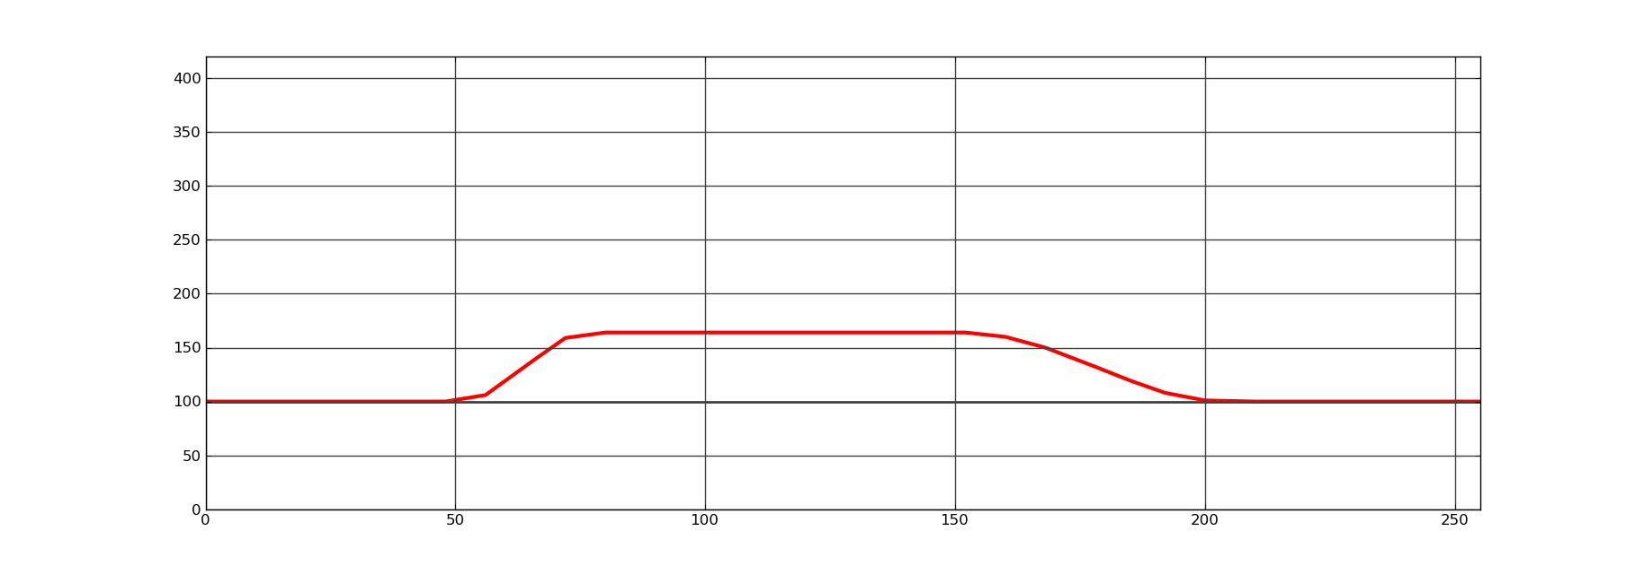
11- Non linear SaturationHSV control
Principles:
Digital polarizing filter effect is limited to mid-saturated pixels. Preventing RGB clipping, and so preserving Hue.
Saturation_{HSV} gain
Saturation_{HSV} in
Damp lowest saturated pixels
Fix gain of saturation
Damp highest saturated pixels
30/37

Slide 31
11- Micro-architecture (RGB domain, full)
RGB to HSV
S_{Max}
*Clip of saturation factor is done at LUT generation.
Hue_{HSV}
YRGB to Sat_{YUV}
Sat
*
Min
Gain of Colour Saturation_{YUV}
Saturation_{YUV}
RGB to Y
S_{Max}
Luminance_{YUV}
RGB Color matrix of saturation
HSV Saturation in RGB
RGB
RGB
RGB to HSV
S_{Max}
Hue_{HSV}
Gain of Colour Saturation_{HSV}
Min
Sat
*
Saturation_{HSV}

Slide 32
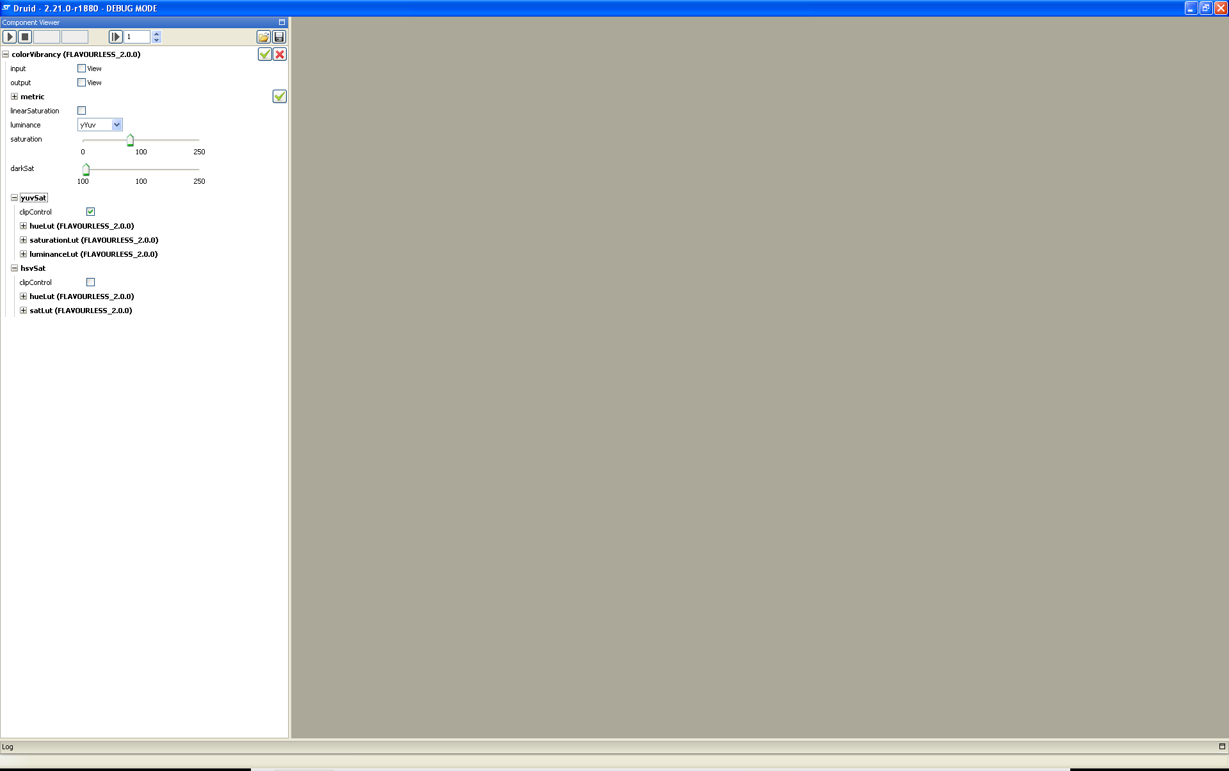
12- Entry level user
Saturation_{YUV} [0:250%]
RGB to HSV
S_{Max}
Hue_{HSV}
YRGB to Sat_{YUV}
Sat
*
Min
Saturation_{YUV}
RGB to Y
S_{Max}
Gain of Colour Saturation_{YUV}
Luminance_{YUV}
RGB
RGB Color matrix of Saturation
HSV Saturation in RGB
RGB
RGB to HSV
S_{Max}
Saturation_{HSV} [100:250%]
Hue_{HSV}
Min
Gain of Colour Saturation_{HSV}
Sat
*
Saturation_{HSV}

Slide 33
12- Advance user model
Saturation_{YUV} [0:250%]
RGB to HSV
S_{Max}
Scene recognition - Compiled exposure - WB colour temperature - Locii stats - Face detection - …
Hue_{HSV}
YRGB to Sat_{YUV}
Sat
*
Min
Saturation_{YUV}
RGB to Y
S_{Max}
Gain of Colour Saturation_{YUV}
Luminance_{YUV}
RGB
RGB Color matrix of Saturation
HSV Saturation in RGB
RGB
RGB to HSV
S_{Max}
Saturation_{HSV} [100:250%]
Hue_{HSV}
Min
Gain of Colour Saturation_{HSV}
Sat
*
Saturation_{HSV}

Slide 34
12- Advantages of Color shaper
Prevention of clipping, whatever is the user desired saturation. This ensures preservation of Hue.
No oversaturation on skins, avoiding red skin effect.
Preservation of neutral pixels.
Ability to hide the chroma noise, specially in lowlight, and darks.
Deeper blue and green colors, thanks to Digital Polarizing filter effect.
Color shaper is less sensitive to scene content, as oversaturation is minimized.
Thanks to LUT approach, flexible adaption of color shaper to scene recognition/modes.
►Thanks to color shaper, the color saturation could be set close to 160% and more. We use to limit the color saturation to 110% due to artifacts.
► Note: Color shaper is better used with scene recognition. Under development: Limit skin desaturation even in low light

Slide 35
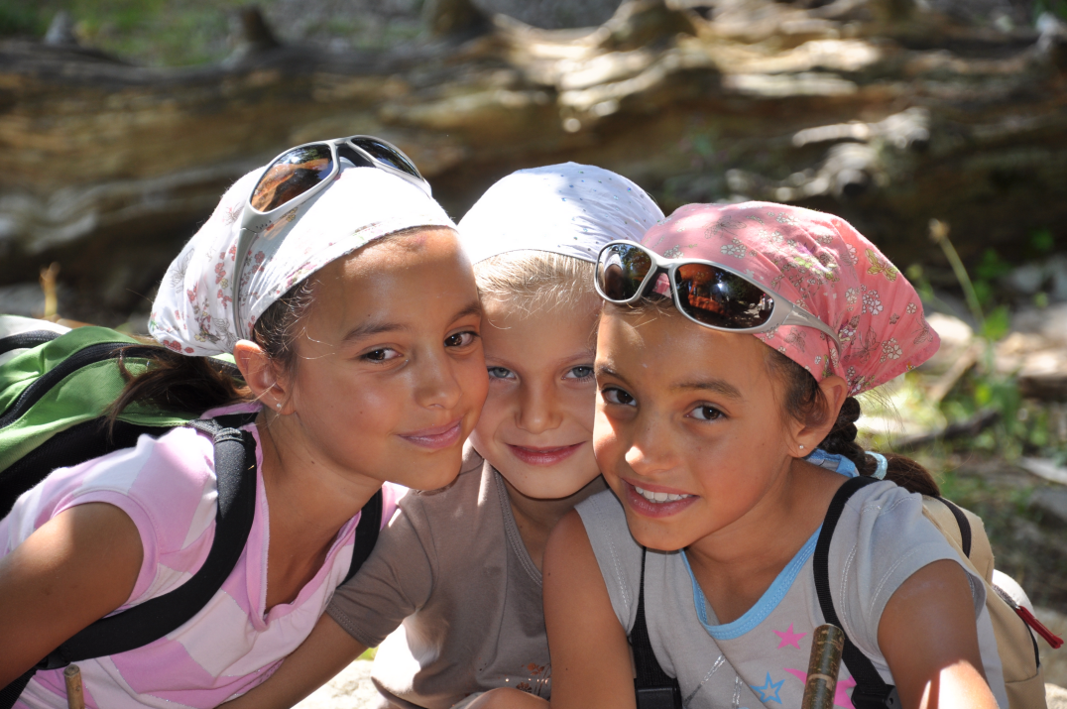
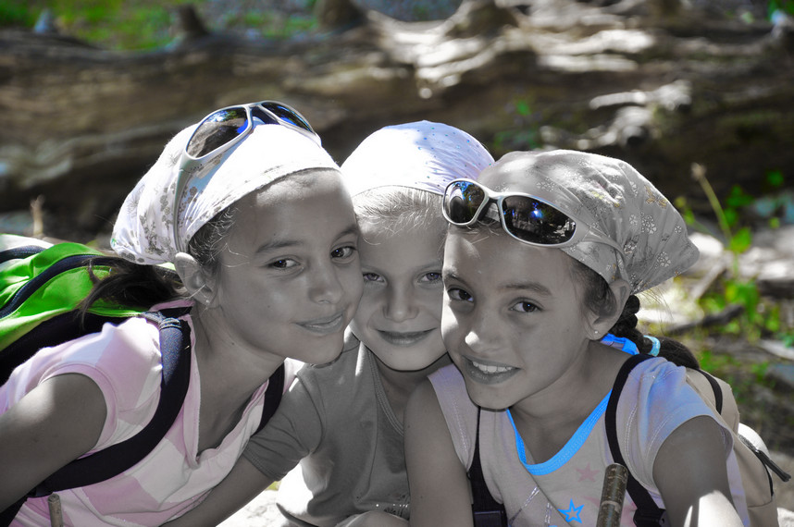
12- Fun effects: selective
Original
Modified

Slide 36
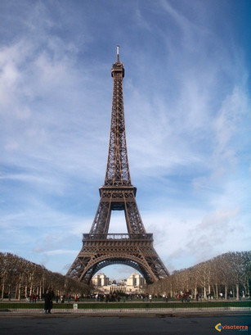
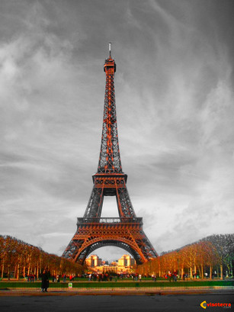
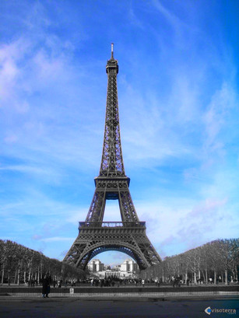
12- Fun effects: selective desaturation
Original
Modified

Slide 37
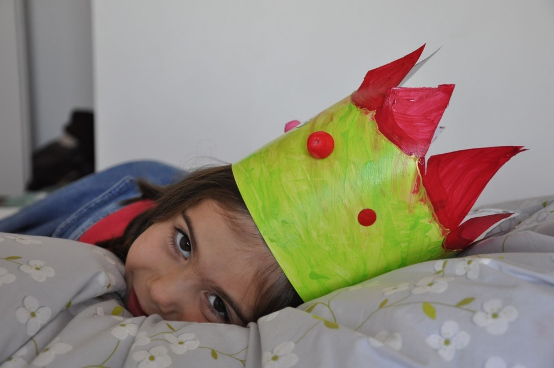
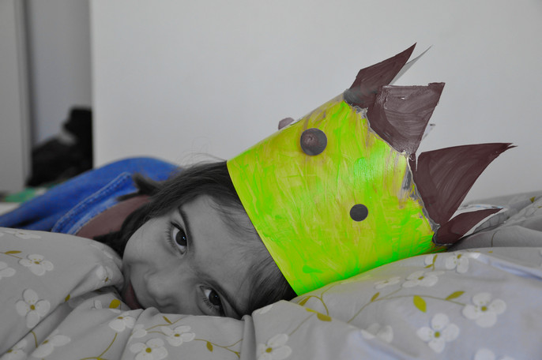
12- Fun effects: selective desaturation
Original
Modified

